Slide 1

Web Development 1
© Hugh McCabe & Matt Smith 2008-2014
Lecture 2b
HTML markup – INLINE elements

Slide 2
Inline Elements
Introduction
We have now covered almost all block level text mark-up HTML elements
We’ll now have a look at most commonly used inline elements.
Remember that this means
elements stay within the flow of the text and do not cause line breaks…

Slide 3
Inline Elements
Semantic Inline Elements
Describe enclosed text’s meaning, context or usage.
They way they look in the browser window depends on a style sheet
either one you provide or the default one the browser uses …
There are only about 10-20 inline elements you are likely to use
More are described IN THE CORE TEXT BOOK !!!!!!!

Slide 4
Inline Elements
The main inline elements for basic web page markup:
Other important inline elements include
Images
Links
we’ll look at this next time …
Element | Description
em | emphasised text
strong | strongly emphasised text

Slide 5
Inline Elements

Slide 6
Inline Elements
Adding emphasis to text
Both em and strong element indicate that text should be emphasised in some way
The strong element means that it should be more strongly emphasised
Example of their use:
<p>
Garamond is a <em>really</em> popular typeface, but Times is a <strong>really really</strong> popular typeface.
</p>

Slide 7
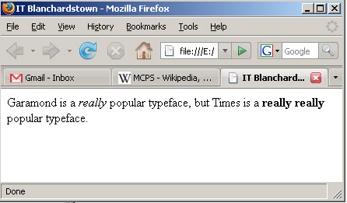
Inline Elements
The default rendering of this is:
Screen readers may read emphasised text in a different tone of voice

Slide 8
WHITESPACE and line BREAKS

Slide 9
WHITE SPACE (spaces, tabs, newlines…)
HTMLs approach to white space is:
Any or nothing
i.e. either there is NO WHITESPACE (no gap between 2 characters), or there is some whitespace
Separating 2 characters can be done by:
SPACE
TAB
NEWLINE
Or any combination - they are all treated the same
?? WHAT ???
See next slide for examples …

Slide 10
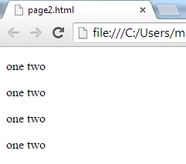
All these are equivalent
<p>one two</p>
<p>one two</p>
<p>one
two</p>
<p>one
two</p>

Slide 11
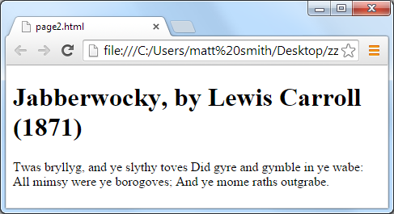
Remember – a NEWLINE or TAB or lots of SPACES are all treated the same as A SINGLE SPACE
If you don’t use <p> or <br> things will not necessarily start on a new line
<h1>Jabberwocky, by Lewis Carroll (1871)</h1>
<p>
Twas bryllyg, and ye slythy toves
Did gyre and gymble in ye wabe:
All mimsy were ye borogoves;
And ye mome raths outgrabe.
</p>

Slide 12
Block Level Elements
LINE breaks
All of the block elements start on new lines.
But sometimes we want to add a new line within a block.
For example we might want to break a paragraph and do so without dividing it into two paragraphs.
E.g. ensure new line of poem on new line
The br element allows this.
It is an empty element that simply forces a line break wherever it is inserted.
<br>

Slide 13
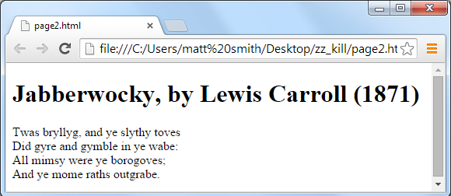
Using <br> we can FORCE text to start on a new line
Line break example
When a line of a poem needs to start on a new line
BUT a new paragraph would be too much (with associated space above and below)
<h1>Jabberwocky, by Lewis Carroll (1871)</h1>
<p>
Twas bryllyg, and ye slythy toves
<br>Did gyre and gymble in ye wabe:
<br>All mimsy were ye borogoves;
<br>And ye mome raths outgrabe.
</p>

Slide 14
<br> WARNING …
You SHOULD not need to use this very often
In most cases using <p> paragraphs is fine
Ensure <br> is INLINE – do NOT place it between blocks like paragraphs
The following is WRONG – DO NOT DO THIS
<p>one two</p>
<br>
<p>one two</p>
<br>
<p>one two</p>
<br>
<p>one two</p>
☹☒ ☹☒ ☹☒ ☹☒ AVOID THIS !!!

Slide 15
ENTITES – special characters/symbols
e.g.
Souflé
© 2012
€ 19.99

Slide 16
ENTITES – special symbols/characters
We may wish to display symbols in the web page that we cannot type on our keyboard
Even if we can type them, they may not be part of the basic ASCII (a-z, 0-9) alphabet
We declare such symbols using HTML ENTITIES
They are defined either by entity name or numeric code
© &copy; © &#169;
€ &euro; é &eacute;
http://www.webstandards.org/learn/reference/charts/entities/

Slide 17
INLINE elements to AVOID
Elements NOT to be used for exam / website project

Slide 18
Inline Elements – Module style guide … – please AVOID using the following
Element | Description
b | program code sample
i | keyboard; text entered by a user
u | sample output from a program
☹☒
Please also avoid the use of:
<b> <i> <u>
While some are permissible in HTML 5, there are better ways of achieving bold / italic / underline
You wil LOSE MARKS if you use these in your assessed work ….
Also avoid these BLOCK elements & attributes
<font> <center> align=“center/left/right” border=“1”

Slide 19
Summary and Conclusions

Slide 20
Summary / Conclusions INLINE elements
Inline elements stay within the flow of the text and do not cause line breaks
Think ‘letters’ or ‘words’ or ‘phrases’
<em> <strong> - to add ephasis
Entities (special characters) e.g.
&copy; &euro; &amp;
NEVER use older presentation mark-ups
<u> <i> <b> <center><font> border=“1” align=“center/left” etc. YOU WILL LOSE MARKS IF YOU USE ANY OF THESE ...

